Slide 1

Oreoluwa Seweje
Sprint 2 Presentation | 2024-04-02
Notes:
Introduce yourself, and what you’re looking to present. Mention that there is a mini-game if anyone is interested. Some images have easter eggs for a movie. If the numbers get boring try to guess the movie before the end of the presentation. For my first and only trick I’ll try to guess where your mind went

Slide 2



From Previous:
Incorporate Methodologies from Recommendation Systems:
To enrich the semantic representation of our dataset, we will adopt strategies inspired by advanced recommendation systems. Specifically, we propose to tokenize each row of our tabular data, thereby encoding richer semantic information within our model’s input data.
Progressive Introduction of Enhanced Data Stages:
The dataset previously outlined represents only the initial phase (Stage 0) of our data preparation process. As part of our model development strategy, we plan to methodically introduce subsequent stages—namely, Stages 1 and 2. These advanced stages will be integrated incrementally during the model training phase, following the establishment of a baseline performance using Stage 0 data alone.
Weight Adapted Loss Function:
This approach will modify the evaluation metric to become a dynamic weighted score, enabling it to adjust responsively to specific periods that present higher error rates. Consequently, this adaptive scoring will inform the optimization of training weights in real-time during the backpropagation process, facilitating improved model robustness and predictive performance.
Notes:
Recap where we left off. Trying to create something that serves as an alternative to credit score. Here were the presumed next steps

Slide 3
Challenges
Some of the struggles faced during this struggle fest
Notes:
The main issue was that of generalization and Handling coverage between test, training and unseen data

Slide 4
Scaling Coverage
PROBLEM
Scaling transformations are based on training data. Looking at the test data, a lot of the numbers for each column were outside the training data bounds
WHY?
This becomes an issue because all scaling attempts shrink values between an upper and lower bound. Hence if we get data that is consistently outside the training data we end up with faulty predictions
Notes:
The main issue was that of generalization and Handling coverage between test, training and unseen data

Slide 5
Categorial Relationships
We deviated from one hot encoding strategy because it limited us to the possibilities of the training set. Any new values would be treated as unknown. For example:
For a feature location the subset is: [TD Bank, Shoppers Drug Mart]
Want a solution that when given CBC Bank or Drug Store it finds similarities with the existing subset. TD Bank ~ CBC Bank etc.
Notes:
The main issue was that of generalization and Handling coverage between test, training and unseen data

Slide 6

Solution
Tokenization and Embeddings
Notes:
Briefly mention that with tokenization we look to convert the tabular information to text and embeddings are a fancier one-hot encoding scheme except each row has trainable weights

Slide 7
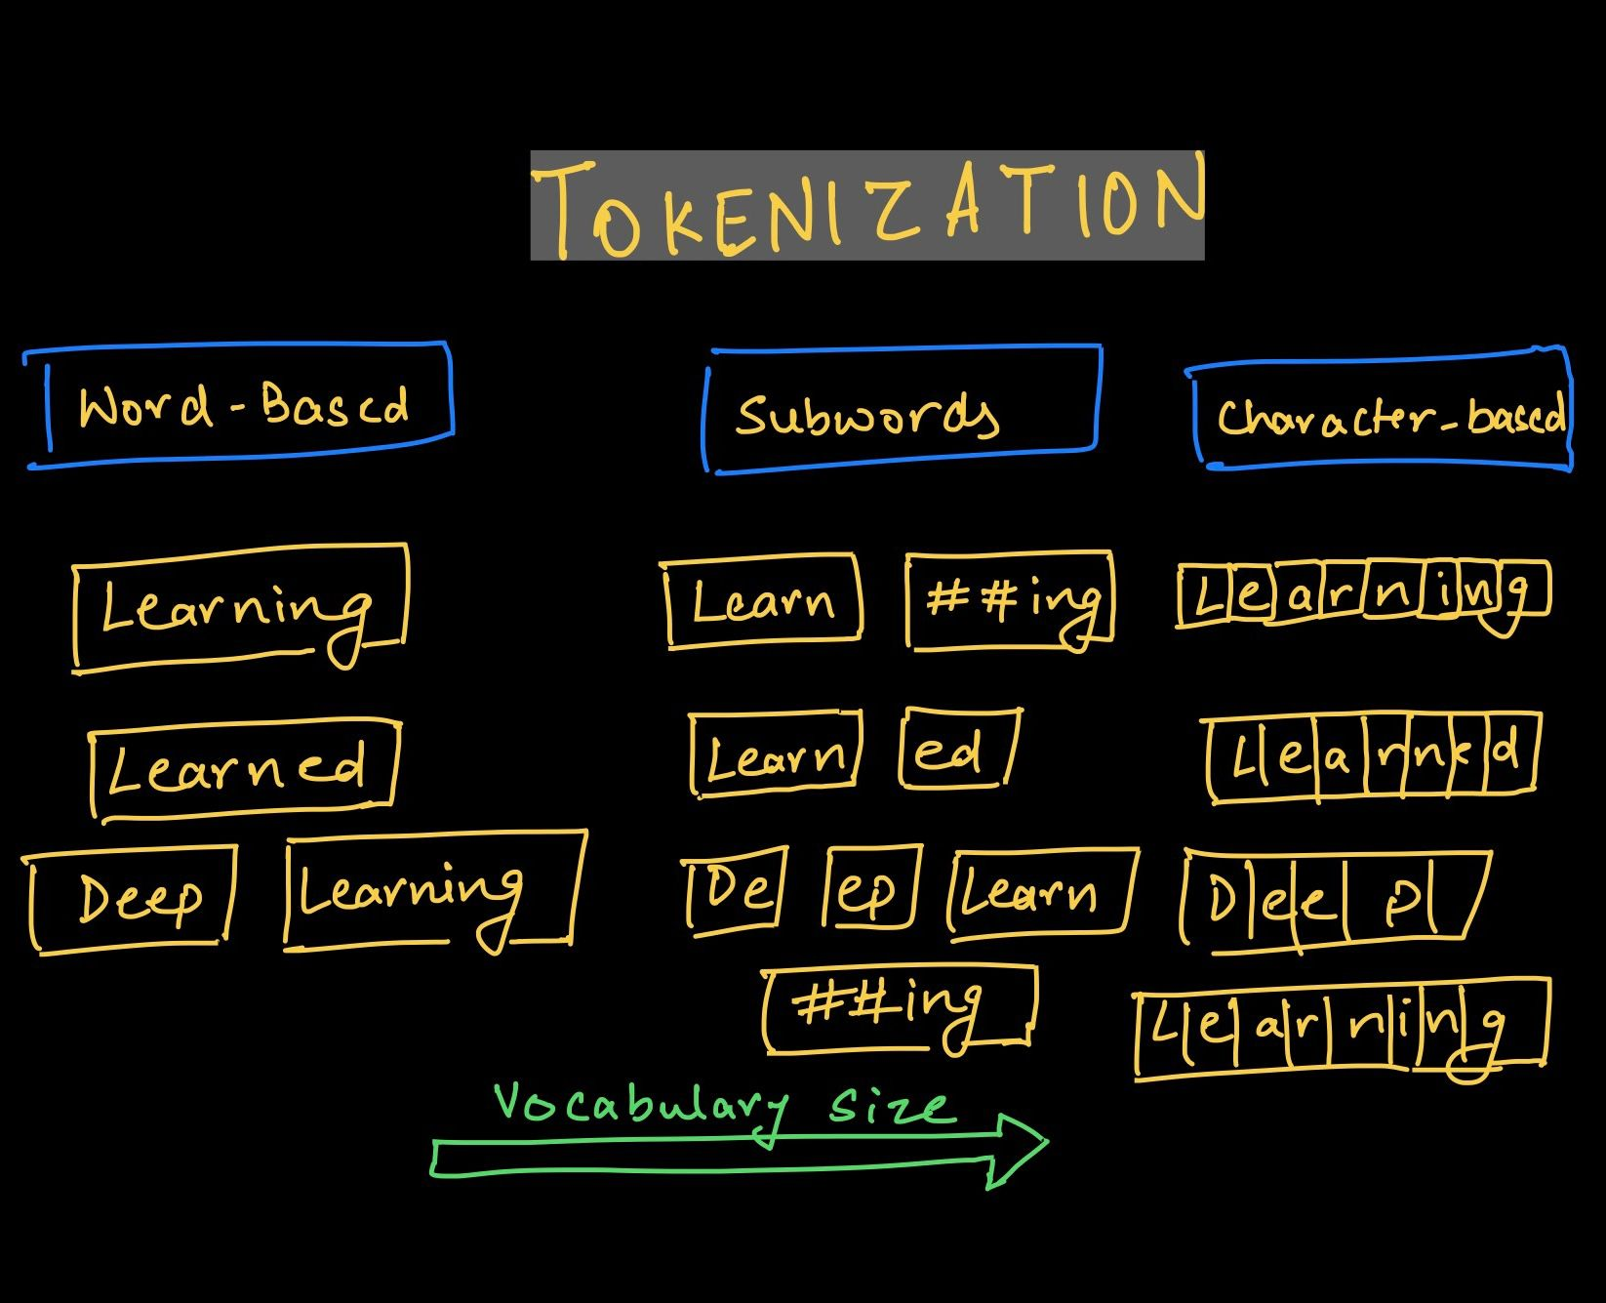
Tokenization Review
Tokenization and Embeddings
Notes:
The main issue was that of generalization and Handling coverage between test, training and unseen data

Slide 8
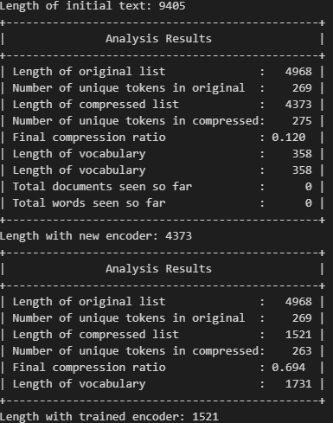
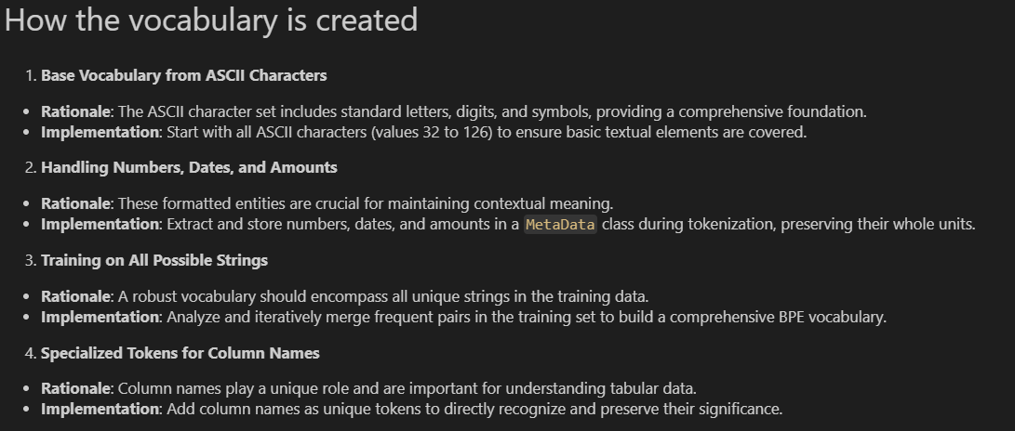
Notes:
The main issue was that of generalization and Handling coverage between test, training and unseen data

Slide 9
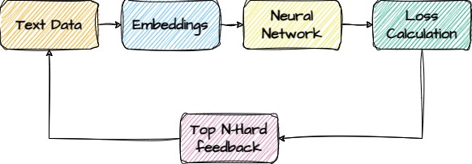
Linking
The overall flow of the algorithm
Notes:
The main issue was that of generalization and Handling coverage between test, training and unseen data

Slide 10
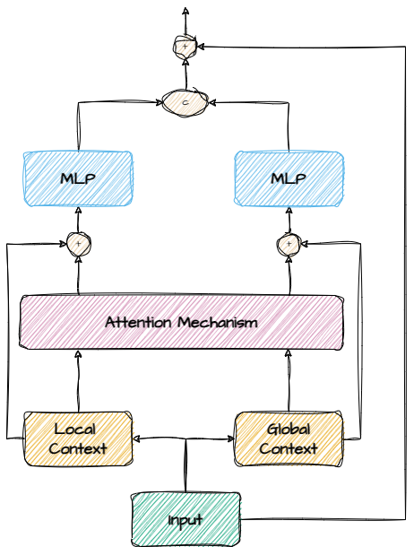
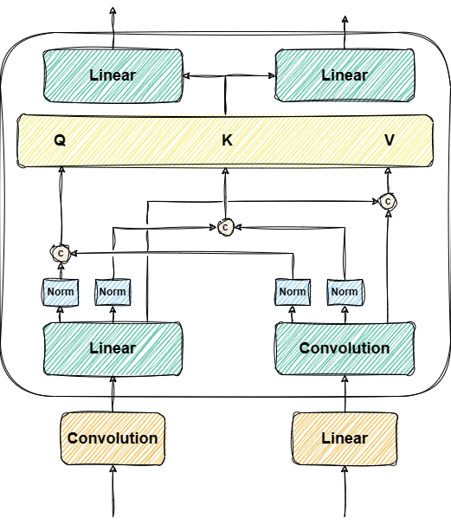
Notes:
The main issue was that of generalization and Handling coverage between test, training and unseen data

Slide 11
END
Notes:
The main issue was that of generalization and Handling coverage between test, training and unseen data

